Slide 1


SoundStage Selector Data-Driven Artist Curation
Optimizing Artist Selection for Concerts Using Multi-Factor Analysis
of Spotify Streaming, Collaboration, and Audience Engagement Metrics
Shreyashri Athani, Sudarshan Paranjape

Slide 2
Agenda
01
02
03
04
05
Introduction
Data
StoryTelling
Problem Statement &
Key Objectives
Data Source, Attributes
Preprocessing
Introduce an User to do Case Study for the problem
EDA & Visuals
Conclusions
Plots charts & Dashboard
Results & conclusions

Slide 3
Objective:
Selecting artists who resonate with the target audience is critical for concert success, as audience preferences vary widely based on:
Kind of concert ( Dance party, Acoustic, live bands, Jazz , EDM festival etc)
Genre (Pop, Rock, Metal, Jazz, EDM, Country)
To make informed decisions, concert organizers need insights into factors like
artist popularity,
potential collaborations,
genre preferences in specific locations.
Significance:
Effective artist selection not only increases audience engagement but also maximizes concert revenue by ensuring high attendance and strong fan interactions and increases return value of the audience.
A well-curated lineup can enhance the audience's concert experience, foster brand loyalty, and generate social media buzz.

Slide 4
Layout:
To assist concert organizers in making data-informed artist selections
This project leverages YouTube & Spotify data, providing valuable insights into artist characteristics and audience engagement metrics.
The goal is to evaluate artists based on attributes such as collaboration history, genre, and audience appeal, helping organizers create concert lineups tailored to audience preferences.
Expected Outcome:
Recommendations Based on Genre, Popularity, and other engagement Metrics: The Interactive dashboard will generate actionable recommendations by identifying artists who align with the target audience's preferences and concert goals, ultimately guiding organizers to choose artists with high engagement and revenue potential for each event.

Slide 5
02
Data

Slide 6
2,079
20,718
11,937
40+
10+
Unique Artists
Songs
Albums
Genres
Countries
Artist Attributes : Artist collaborated with, Country, Genre, No of songs
Collaborated
Spotify Attributes : Url, Track, Album, Album_type, Danceability, Energy, Key
Loudness, Speechiness, Acousticness, Liveness, Duration_ms
Youtube Attributes : Yt_Url, Channel, Views, Likes, No of Comments, Description,
Licensed, Official Video, No of Streams

Slide 7
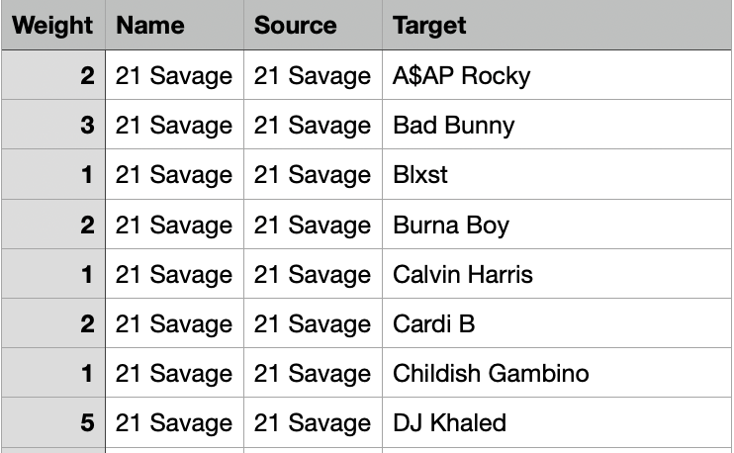
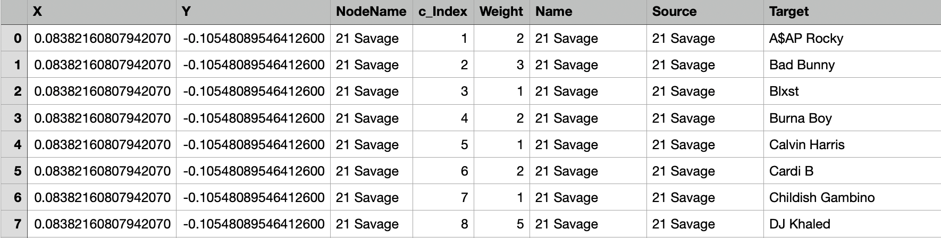
Created terms and preprocessing:
- Engagement score = weighted sum of likes, comments and views
- Collab impact = collab songs / collab individuals
- Main genre - categorised varied genre in common categories
- Track count = used groupby function to get count of track
- Removed irrelevant columns (Spotify urls, youtube channel, youtube url link etc)
Preprocessing for network graph:
Node positions are computed using the Fruchterman-Reingold algorithm, a force-directed layout method that balances repulsive and attractive forces to create an intuitive and visually appealing graph structure.

Slide 8
Preprocessing for network graph:
Node positions are computed using the Fruchterman-Reingold algorithm, a force-directed layout method that balances repulsive and attractive forces to create an intuitive and visually appealing graph structure.

Slide 9
Source : Kaggle
- https://www.kaggle.com/datasets/salvatorerastelli/spotify-and-youtube - 2022 - 2023
- https://www.kaggle.com/datasets/terencicp/musical-collaborations-between-top-artists-in-2022 - 2023
Artist Table:
Column | Description
Collaborated songs | Number of songs an artist collaborated on.
Genres | Genres associated with the artist.
Collab Individuals | Number of other artists the artist collaborated with.
Country | Country of the artist.

Slide 10
Youtube & Spotify Table:
Instrumentalness | Likelihood of no vocals (0.0 to 1.0 scale).
Liveness | Probability that the track is live (0.0 to 1.0 scale).
Valence | Positiveness of the track (0.0 to 1.0 scale).
Tempo | Speed of the track in beats per minute (BPM).
Duration | Duration of the track in milliseconds.
Views | Number of YouTube views.
Likes | Number of YouTube likes.
Comments | Number of YouTube comments.
Track | Song name on Spotify.
Artist | Name of the artist.
Danceability | Suitability for dancing (0.0 to 1.0 scale).
Energy | Intensity of the track (0.0 to 1.0 scale).
Loudness | Average loudness in decibels (dB).
Speechiness | Presence of spoken words (0.0 to 1.0 scale).
Acousticness | Confidence measure for acoustic nature (0.0 to 1.0).

Slide 11
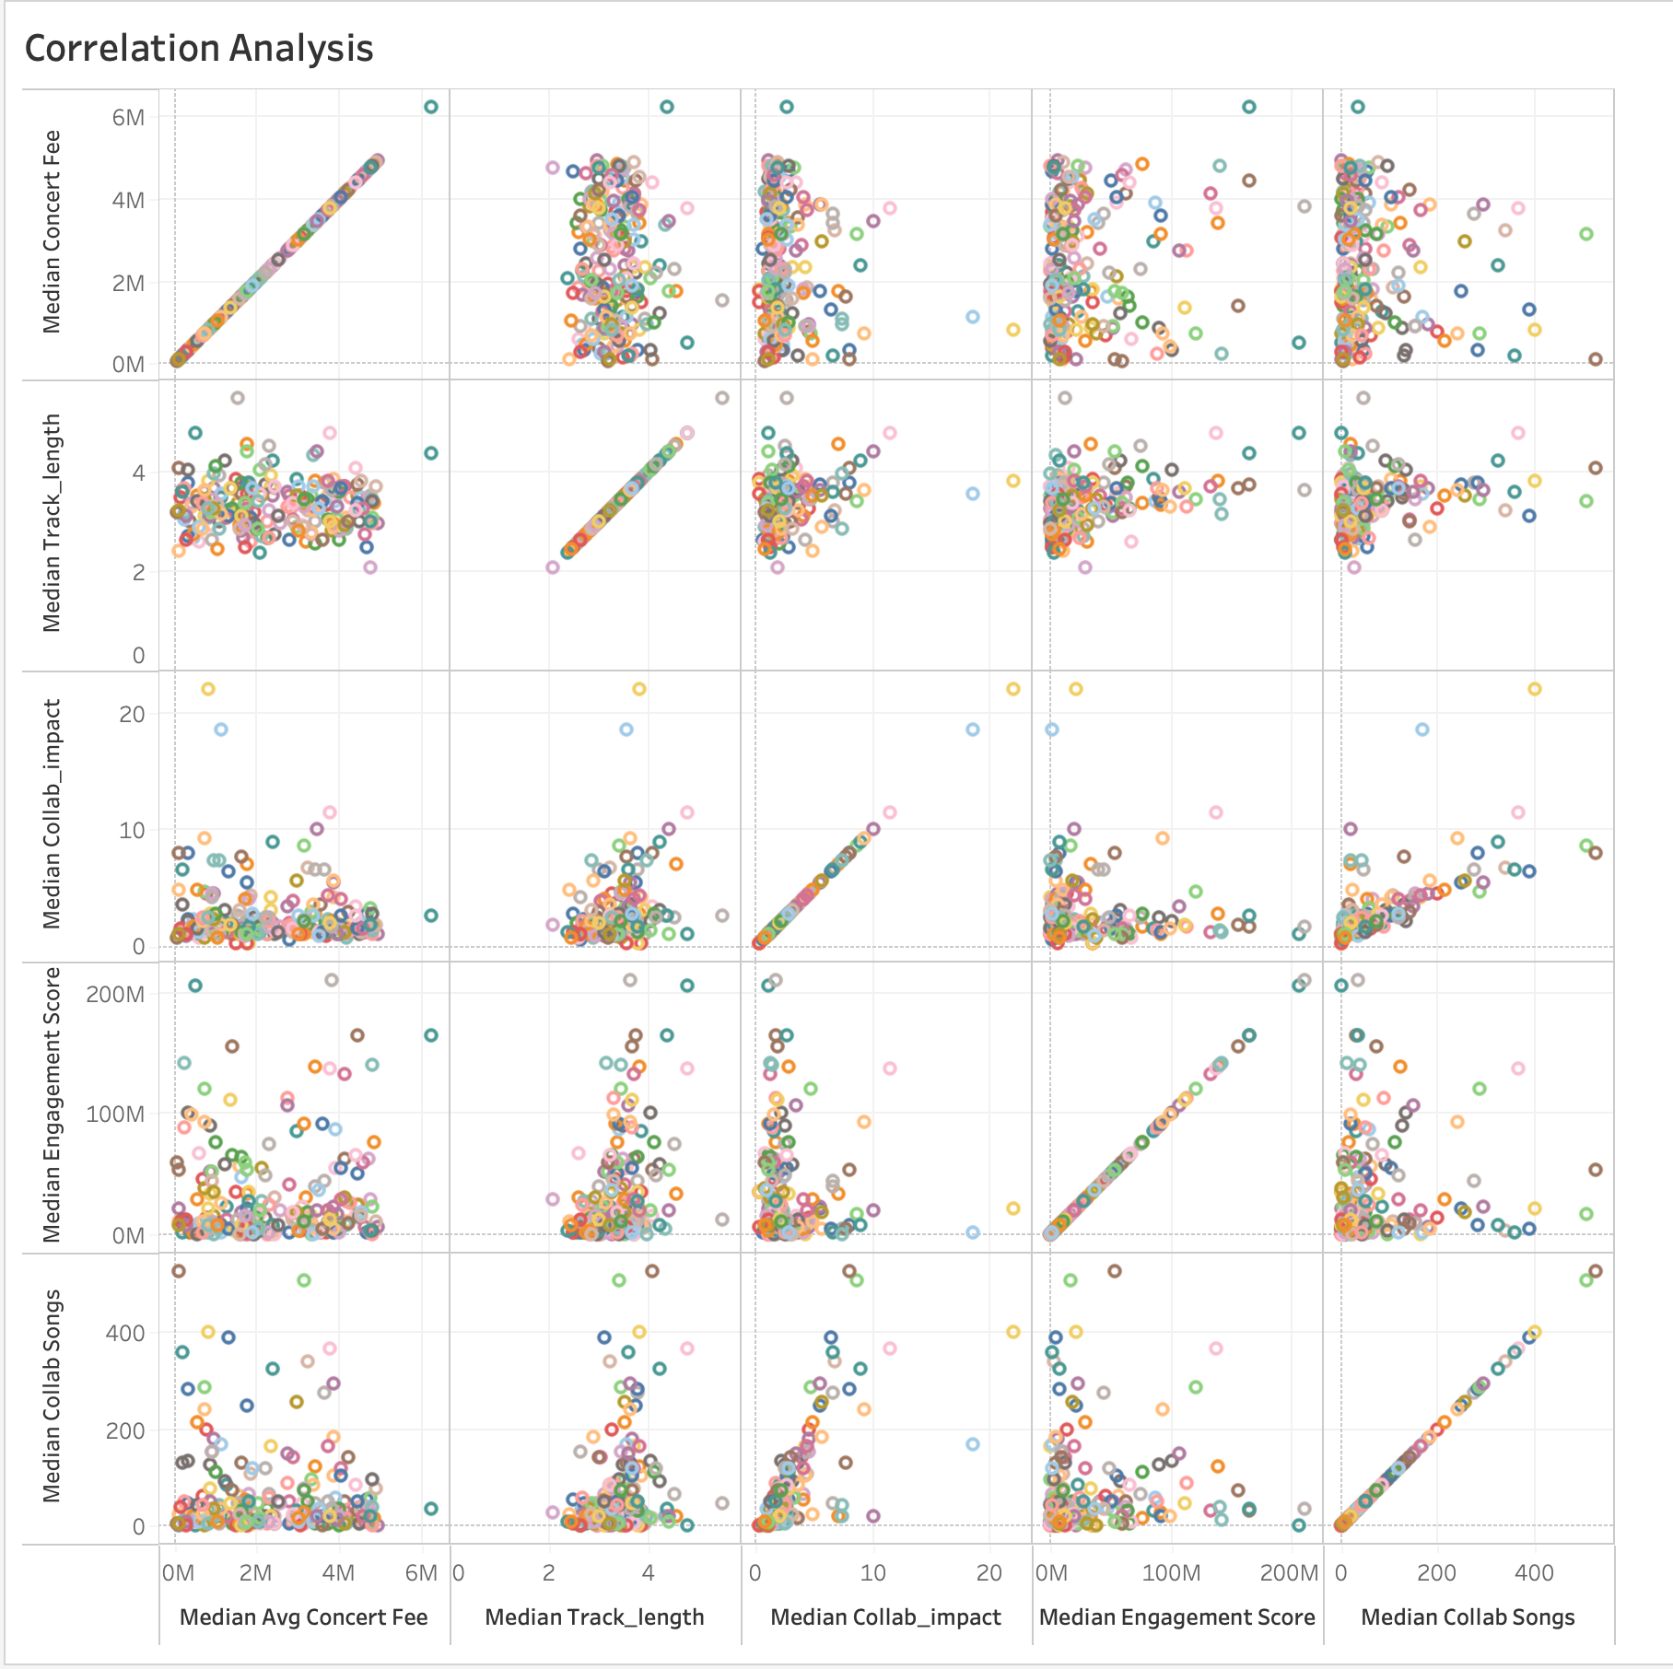
Correlation Analysis:
Artist Fee Correlation: concert fees show a strong positive correlation with collaboration impact, suggesting longer tracks and impactful collaborations contribute to higher earnings.
Engagement vs. Collaborations: Higher engagement scores are associated with a larger number of collaborations, indicating collaborations can enhance audience engagement.
Outliers: Certain artists (e.g., Snoop Dogg) stand out with high collaboration impact and a significant number of collaborative songs, showcasing their influence in the industry.
Notes:
Concert fees show a strong positive correlation with track length and collaboration impact, highlighting that longer tracks and impactful collaborations significantly boost artist earnings.
Additionally, higher engagement scores are linked to a larger number of collaborations, emphasizing the role of partnerships in enhancing audience reach and interaction.
Notably, artists like Snoop Dogg emerge as key outliers, with exceptionally high collaboration impact and a substantial number of collaborative tracks, demonstrating their pivotal influence and marketability in the music industry."

Slide 12
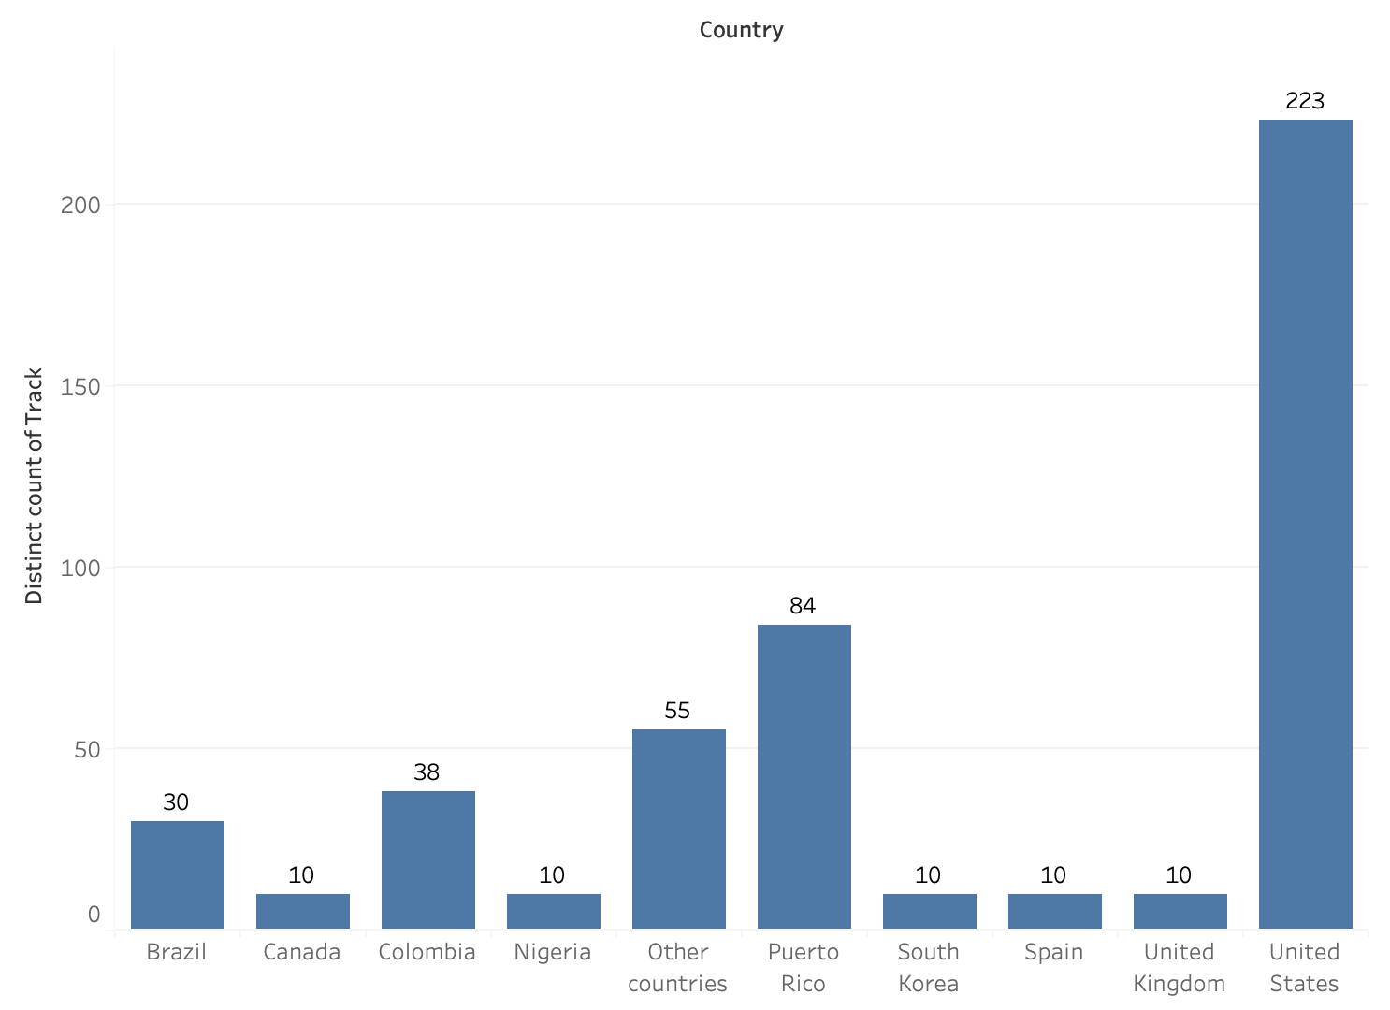
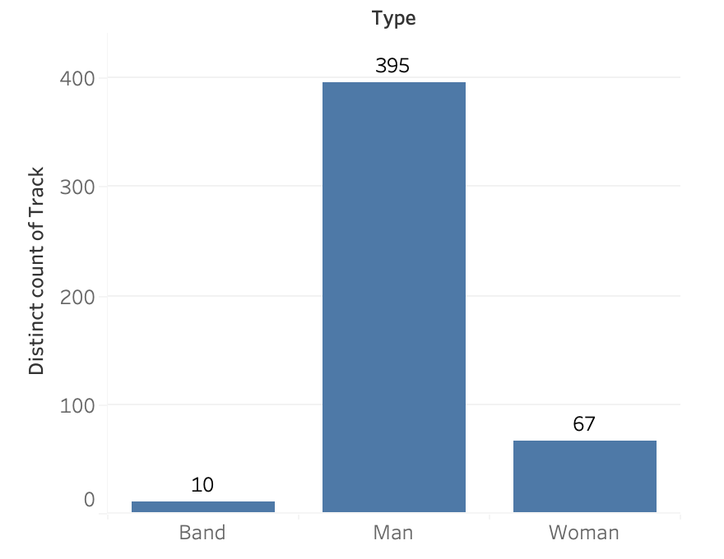
Data Bias:
United States Dominance: The U.S. leads significantly in track production (223 tracks), followed by Puerto Rico (84) and Colombia (38), highlighting its central role in the global music industry.
Gender Disparity: Male artists dominate with 395 tracks, compared to only 67 by women and 10 by bands, suggesting notable gender and group underrepresentation.
Regional and Type Trends: The dominance of male solo artists aligns with the U.S.'s high track counts, while bands and non-U.S. countries show limited contributions.

Slide 13
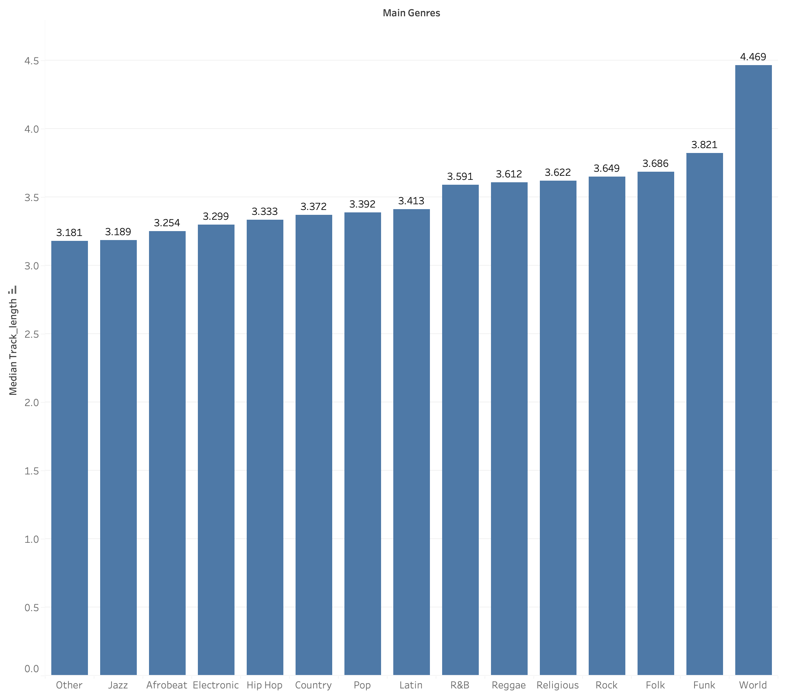
Song Duration:
Artist Fee Correlation: concert fees show a strong positive correlation with collaboration impact, suggesting longer tracks and impactful collaborations contribute to higher earnings.
Engagement vs. Collaborations: Higher engagement scores are associated with a larger number of collaborations, indicating collaborations can enhance audience engagement.
Outliers: Certain artists (e.g., Snoop Dogg) stand out with high collaboration impact and a significant number of collaborative songs, showcasing their influence in the industry.

Slide 14
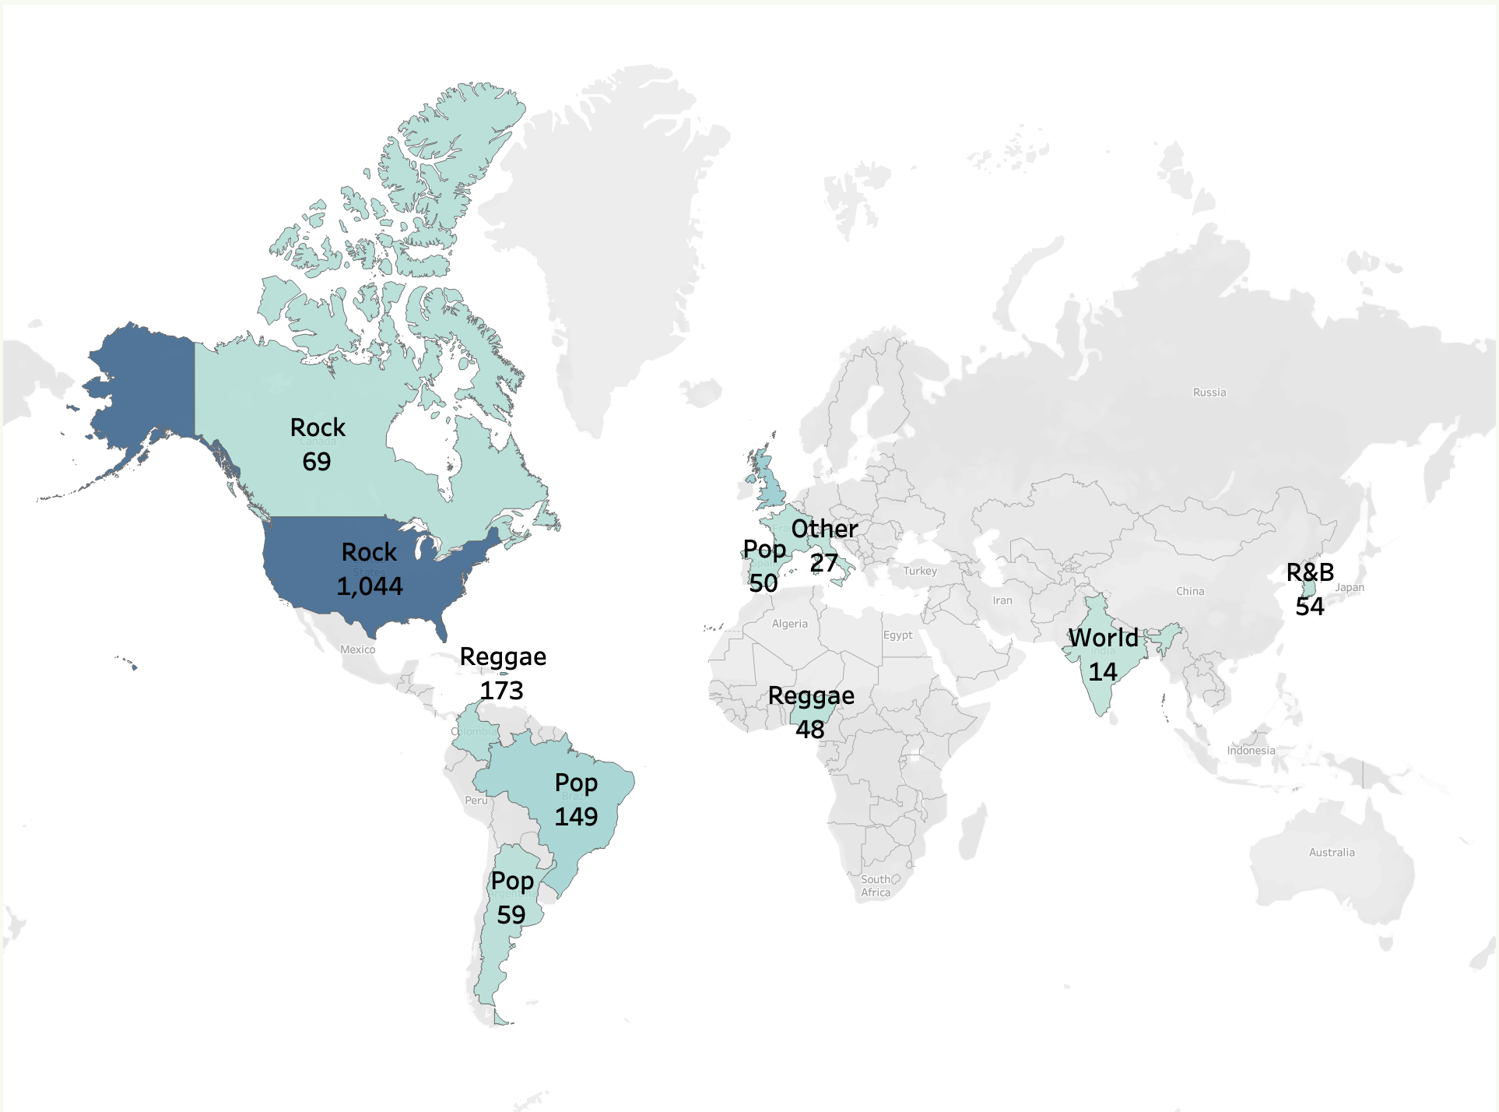
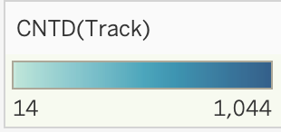
Genre Across The world:
Rock leads the U.S. with 1044 tracks, showcasing its dominance in the North American music scene.
Pop emerges as a versatile genre, appearing in South America (200+ tracks), and other regions.
Regional Genres like Reggaeton (South America, 173 tracks) and Indian Pop (India, 14 tracks) emphasize culturally specific musical influences.

Slide 15
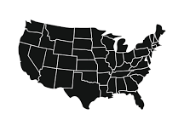
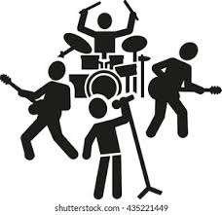

User Story
Concert
Location
Artist?
Let’s organise a concert! Where?
USA!
Which genre of music?
Have the done collabs?
Will the audience like them?
Will the performance be danceable?
Will it be lively?
Is it high tempo?

Slide 16
02
Dashboard

Slide 17
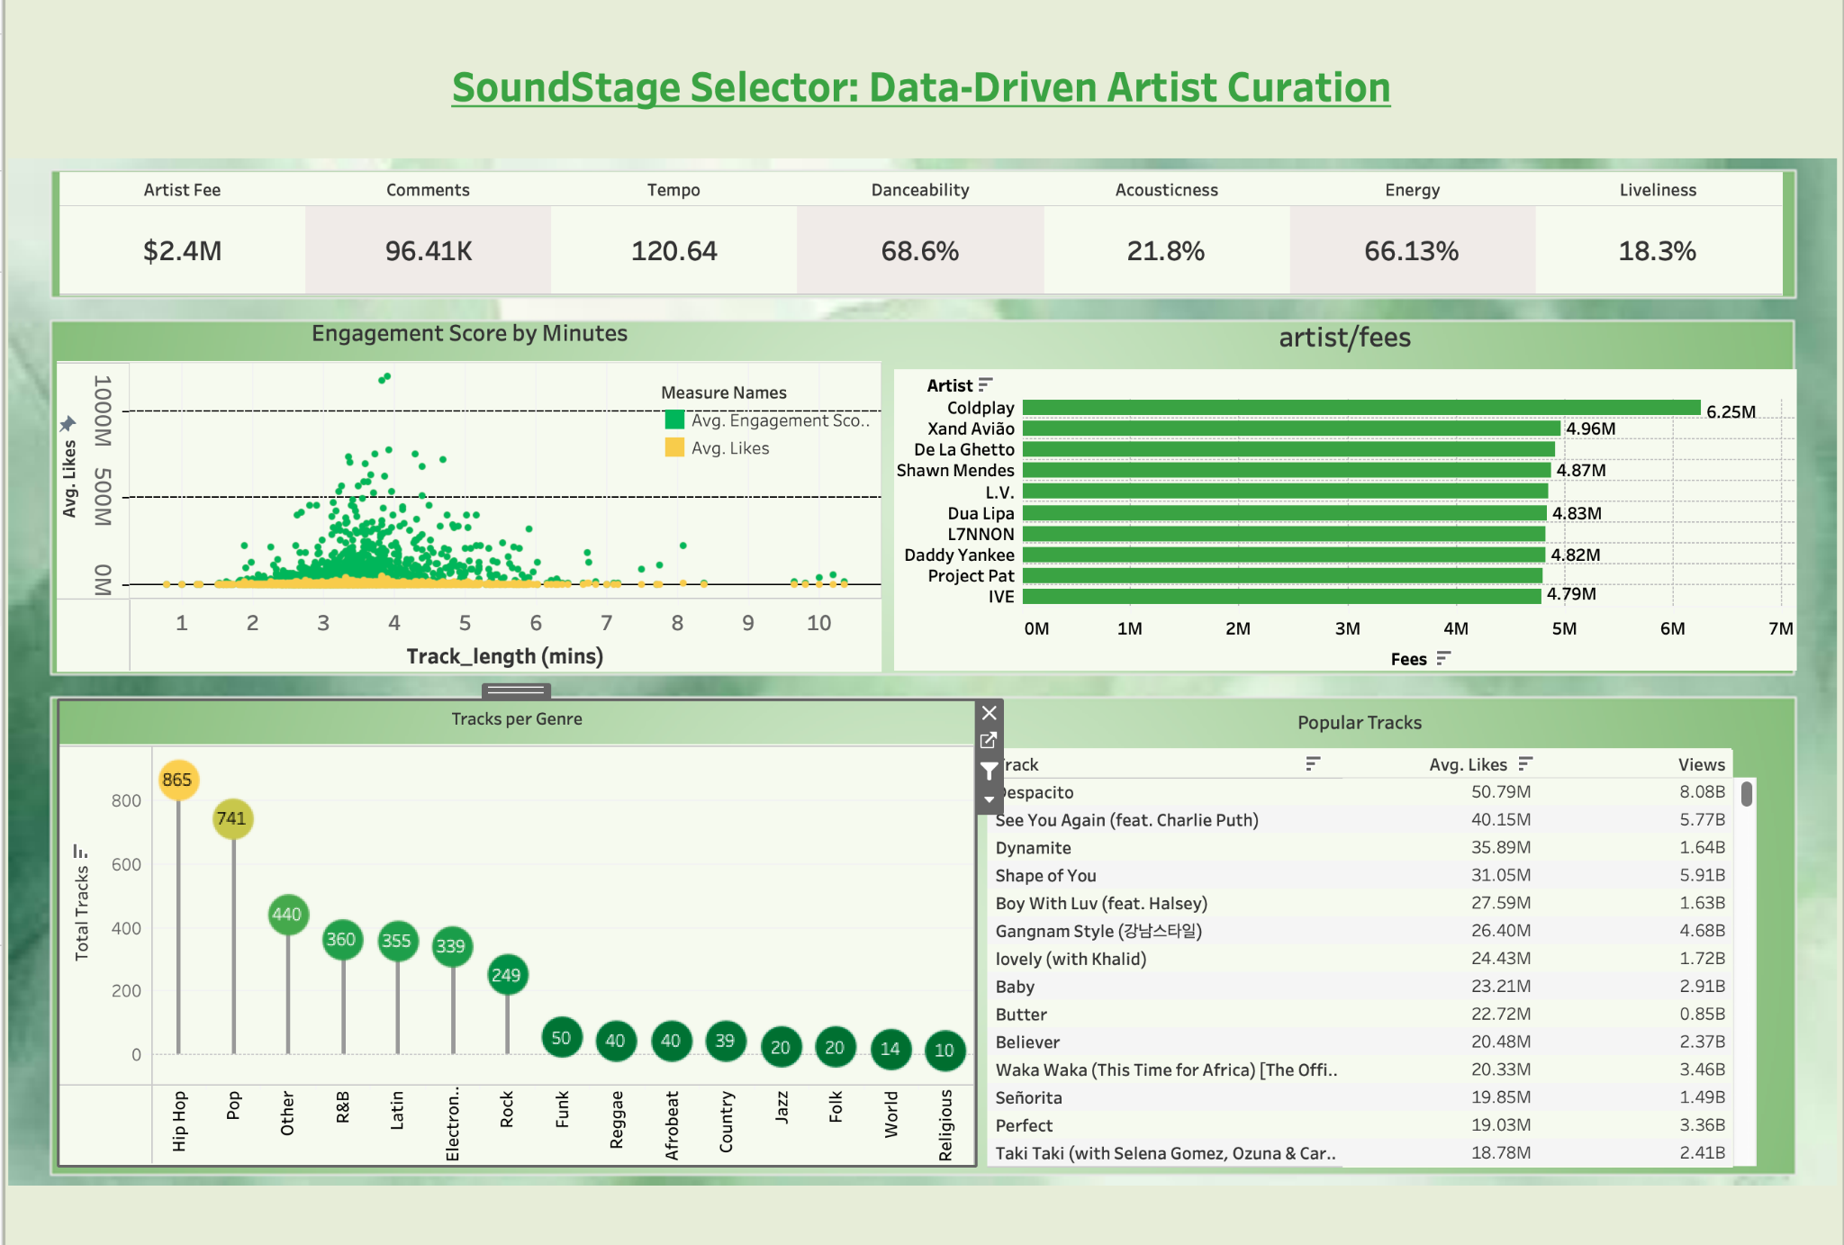

Slide 18
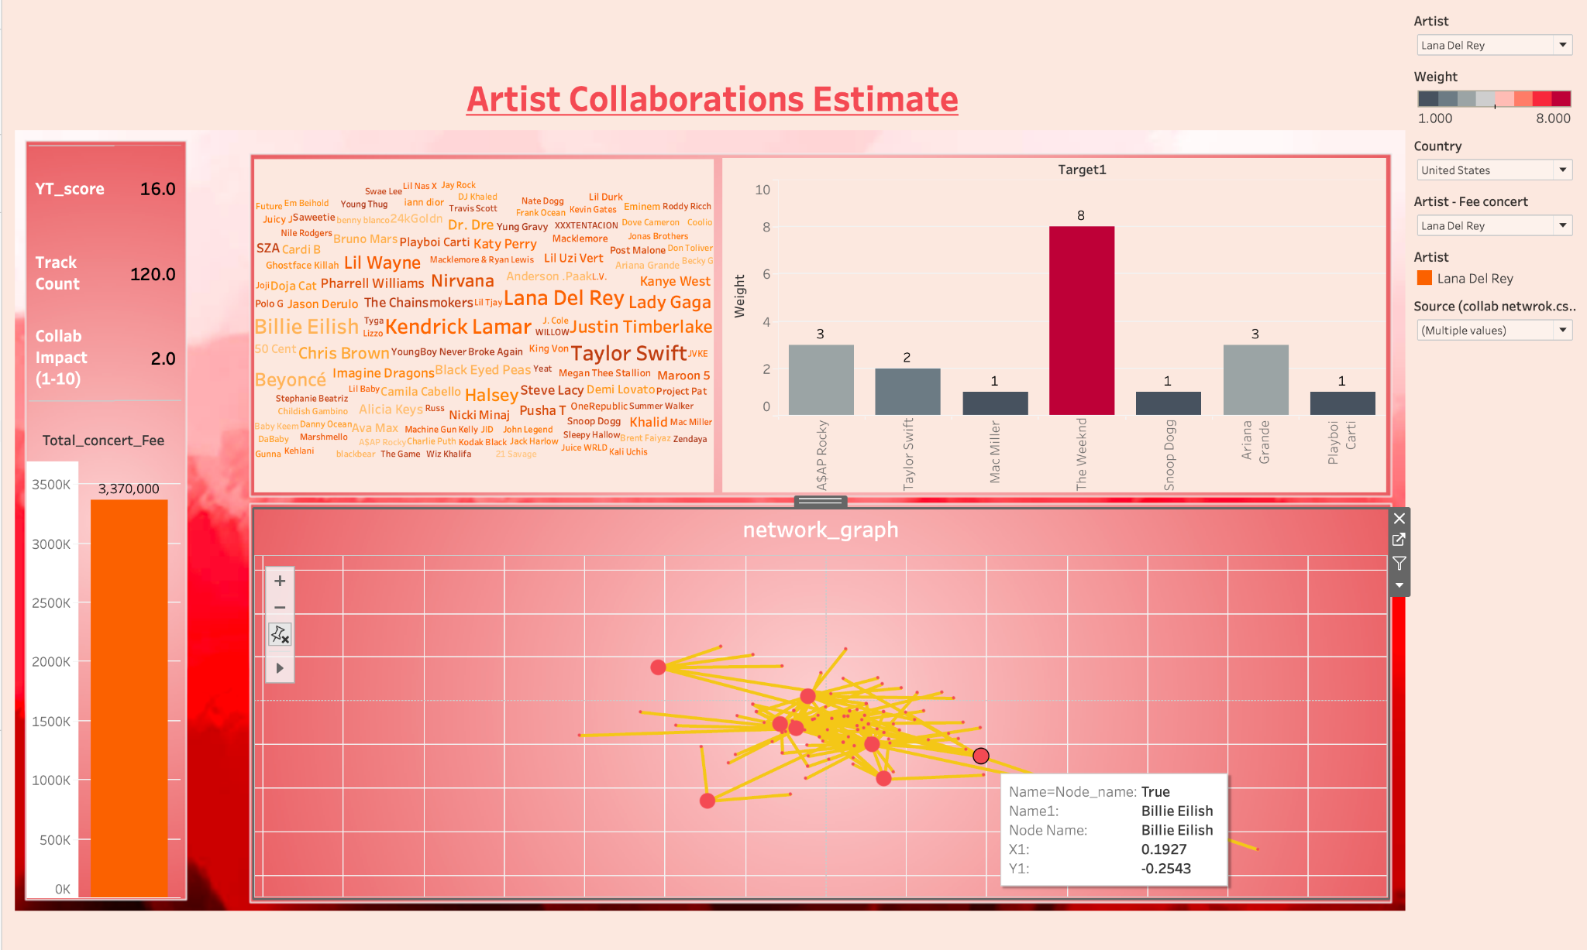

Slide 19
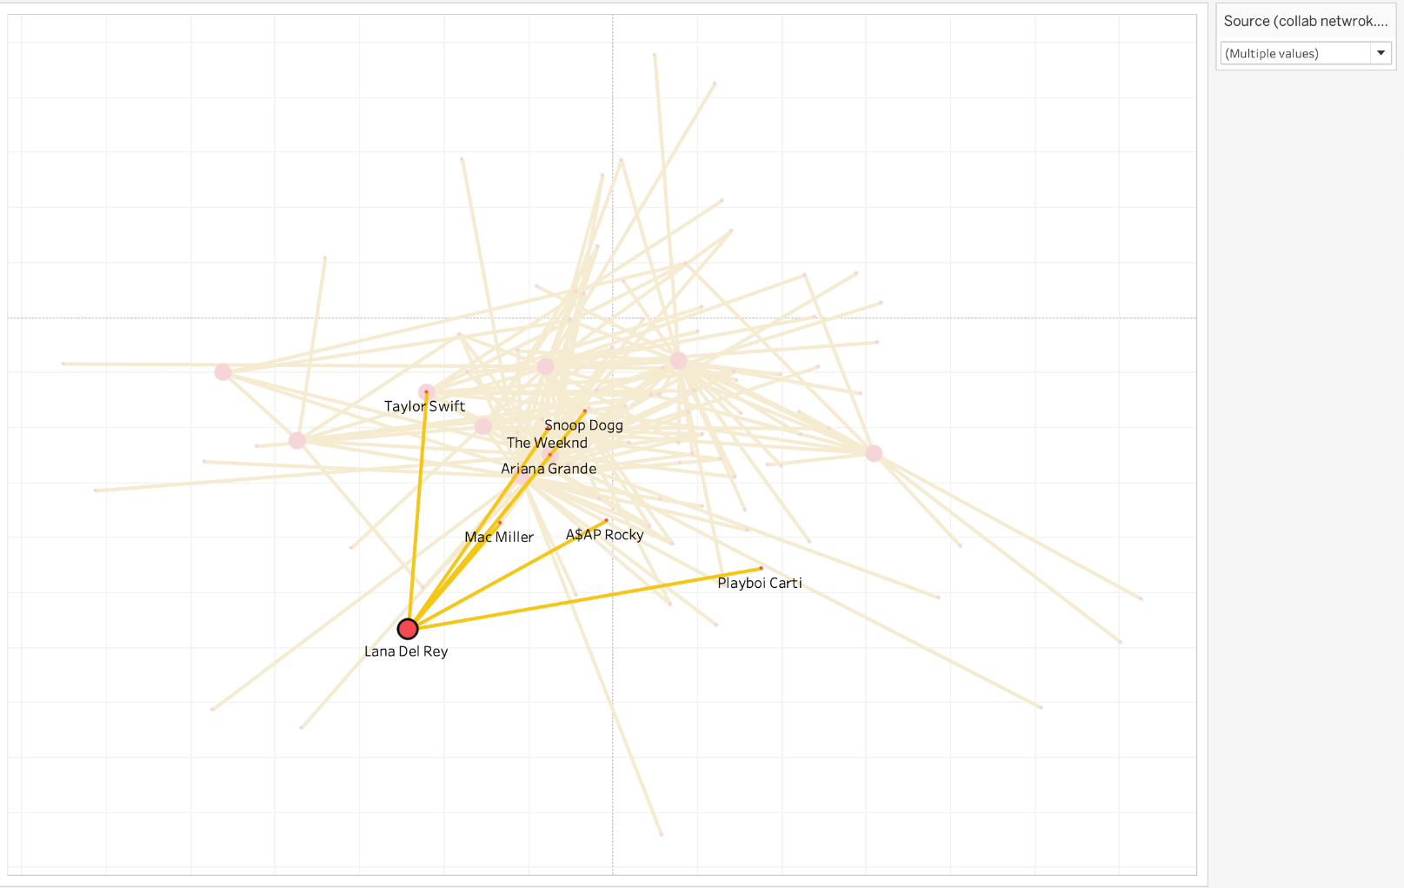

Slide 20
Conclusion
Collaboration vs. Popularity Trade-Off: Artists with high collaboration impact tend to have lower concert fees and engagement scores.
Track Duration Sweet Spot: Most popular tracks fall within the 3–5 minute range, optimizing listener appeal.
Jazz is 3-4 minutes
World is 4-5 minutes
Rock is 3-4 minutes
Pop is 3-4 minutes
Regional and Genre Insights: The U.S. dominates artist count and global collaborations, while niche genres like World and Jazz cater to specific audiences; rappers lead in high collaborations.
Music Features and Genre Correlation: Acousticness, Loudness, and Tempo strongly influence genre classification.

Slide 21
Thank You!

